Slide 1
Software Development methodologies

Slide 2
Methodologies
Waterfall
Prototype model
Spiral
Scrum
Agile
Lean
XP
V-model

Slide 3
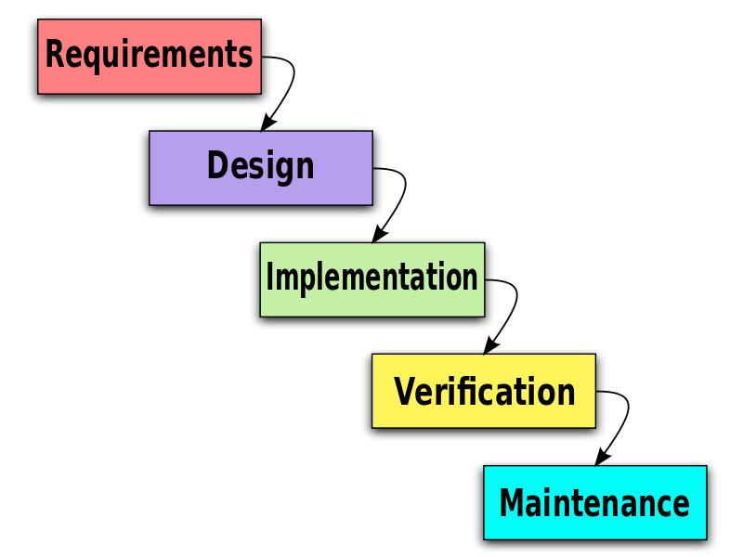
Waterfall
Sequential design process
Progress is seen as flowing steadily downwards (like a waterfall) through SDLC

Slide 4
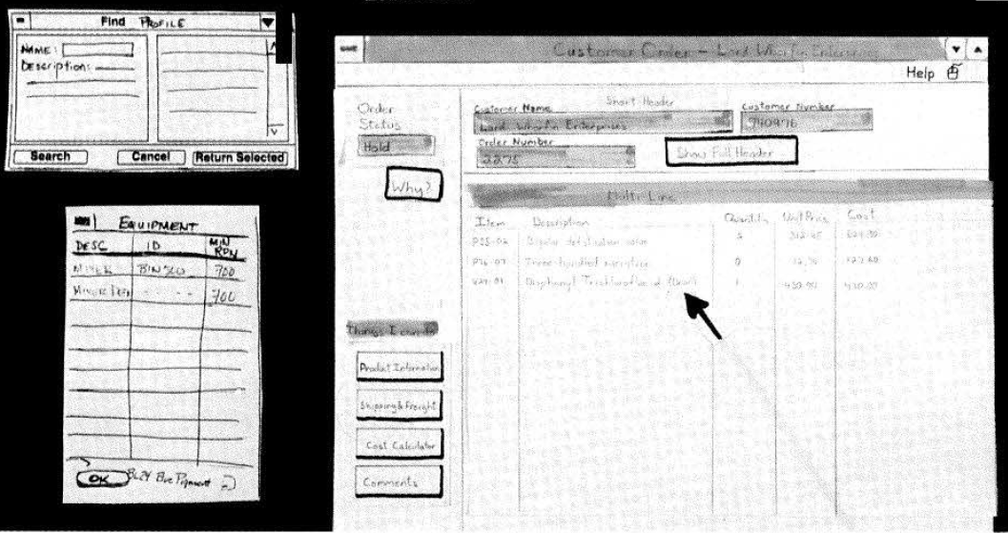
Prototyping
Creating prototypes of software applications i.e. incomplete versions of the software program being developed
A prototype typically simulates only a few aspects of, and may be completely different from, the final product.

Slide 5
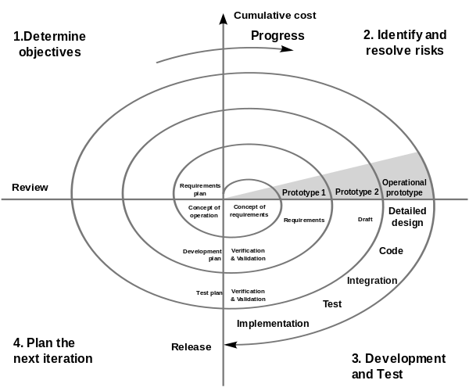
Spiral Model
Combining elements of design and prototyping-in-stages
Combines the features of the prototyping and the waterfall model
The spiral model is intended for large, expensive and complicated projects
Advantages of top-down and bottom-up concepts

Slide 6
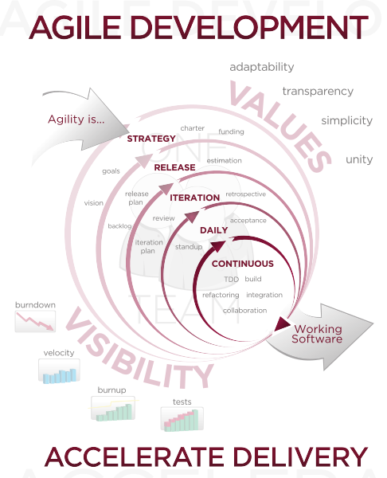
Agile
Group of software development methods
Based on iterative and incremental development
Most important phrases
self-organizing, cross-functional teams
adaptive planning,
evolutionary development and delivery,
a time-boxed iterative approach,
rapid and flexible response to change.
A conceptual framework
The Agile Manifesto in 2001.

Slide 7
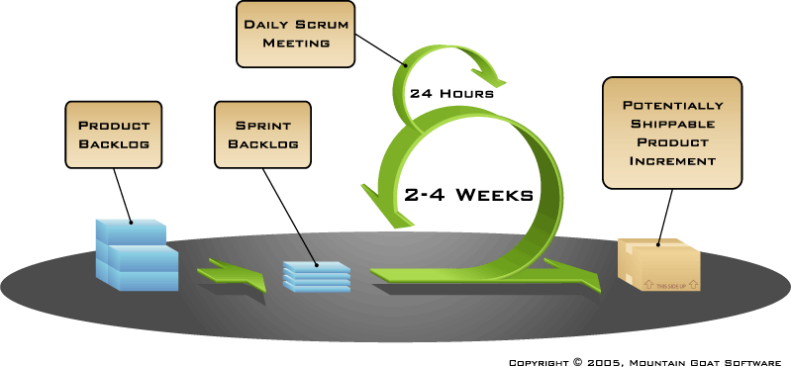
Scrum
Scrum is an iterative and incremental agile software development framework
A flexible, holistic product development strategy
Development team works as an atomic unit
Opposing to sequential approach

Slide 8
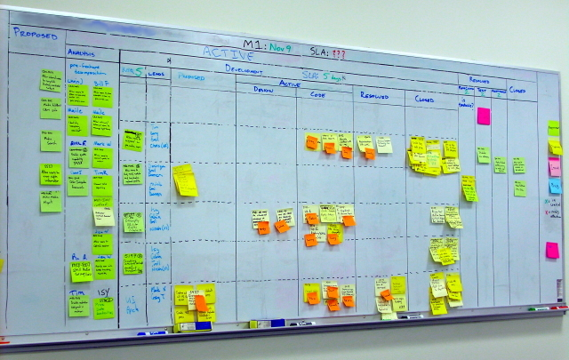
Lean (Kanban)
A translation of lean manufacturing principles and practices
Toyota Production System,
Today part of Agile community.

Slide 9
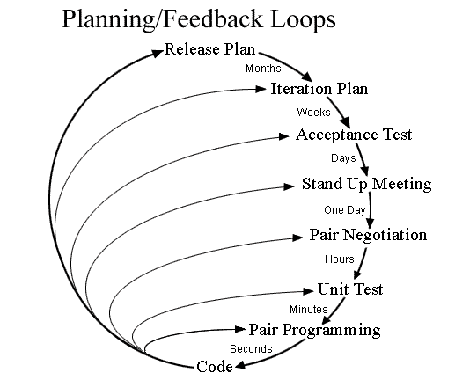
Extreme Programming (XP)
Improve software quality and responsiveness to changing customer requirements
A type of agile software development
Frequent "releases" in short development cycles
Introduce checkpoints where new customer requirements can be adopted.

Slide 10
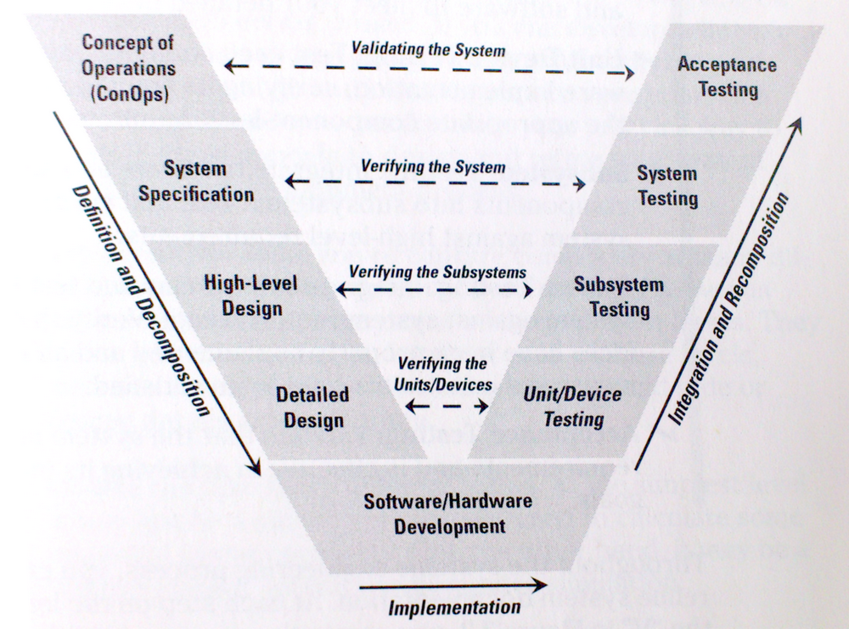
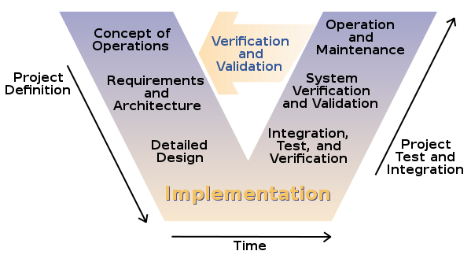
V-model
The V-model is an extension of the waterfall model.
Show the relationships between development phases and test phases
Time and project completeness vs. level of abstraction

